Slide 1


Slide 2

ADVANCE CONCEPTS
IN OBJECTS

Slide 3
The toString() Method
To understand what is toString() method, guess the output of the following code:
let myCar = new Object();
myCar.company = "Maruti";
myCar.model = "Baleno";
myCar.year = 2014;
document.write(myCar);
Output:
[object Object]

Slide 4
Why Was The Output Like This ?
When we define our own object in JavaScript, it inherits the default toString( ) method from Object.
This default implementation of this method returns a string of the form:
[object type]
where type is the type of the object: a value such as “Object”, “String”, “Number”, “Function”, “Window”, “Document”, and so on.

Slide 5
When JS Calls toString( ) ?
Now whenever we pass our object to document.write() or alert() or whenever the object is used in a string context ,the JavaScript system invokes the toString( ) method to convert the object to a string.
For example:
alert(myCar); // will call myCar.toString()
document.write(myCar); // will call myCar.toString()
var message=“Hello “+myCar; // will call myCar.toString()

Slide 6
Overriding toString()
To change this output , we must properly override the method toString() while defining our object in such a way that it should return the properties of the object as a string
For example:
let myCar = new Object();
myCar.company = "Maruti";
myCar.model = "Baleno";
myCar.year = 2014;
myCar.toString = function() {
return myCar.company + "," + myCar.model + "," + myCar.year; }
document.write(myCar);

Slide 7
PROGRAM
WAS to create an object called company with the following properties and methods:
name: should be set to “Apple”
foundationYear: should be set to 1976
productsList: should contain 2 products with first product name set to “iPhone”,it’s year set to 2007 and second product’s name set to “iPad” and it’s year set to 2010
foundedBy: should be set to “Steve Jobs”,”Steve Wozniak”
ceo: should be set to “Steve Jobs”
A method called createNewProduct(): which should accept product details as parameter and add it to the productList
A method called resign(): which should remove ceo ,make the ceo post vaccant and return the name of the ceo.
A method called hireCeo(): which should accept a string “Tim Cook” and set it as the ceo.
A method called toString(): which returns the name , foudationYear,ceo,productsList as a single string separated with newline.

Slide 8
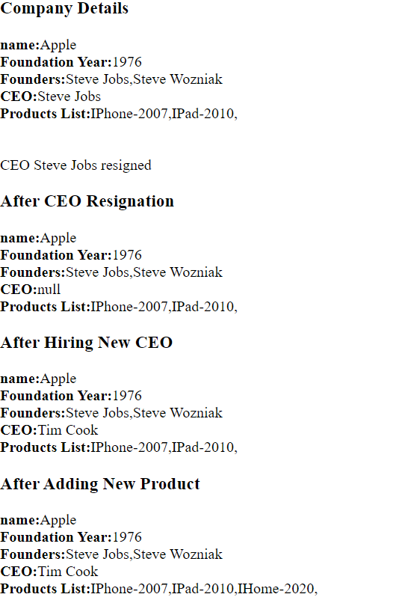
REQUIRED OUTPUT

Slide 9
Object Equality In JS
We know that == and === operators compare value and value & type both for all the primitives like Number , String , Booleans etc.
For example:
let a=10;
let b=10;
console.log(a===b); // will return true
let x=“sachin”;
let y=“sachin”;
console.log(x===y); // will return true

Slide 10
Object Equality In JS
But when we use the same == and === operators on objects , the behaviour is quite different
For example:
let person1 = {
name: "sachin",
gender: "male"
};
let person2 = {
name: "sachin",
gender: "male"
};
document.write(`${person1===person2}<br>`); // will return false

Slide 11
Object Equality In JS
The reason for this is that internally JavaScript compares objects by their reference.
That comparison by reference basically checks to see if the objects given refer to the same location in memory.
For example:
let person1 = {
name: "sachin",
gender: "male"
};
let person2 = person1;
document.write(`${person1===person2}<br>`); // will return true

Slide 12
Object Equality In JS
To overcome this problem we first have to stringify the objects and then use === operator to compare them.
This is done using JSON.

Slide 13
What Is JSON ?
The term JSON stands for JavaScript Object Notation and is the most popular mechanism of exchanging data between a browser and a server.
JSON allows us to convert any JavaScript object into JSON string, and send that JSON string to the server.

Slide 14
What Is JSON ?
Like Date , Array etc JSON is also a predefined object present in JavaScript and has a bunch of useful methods .
Amongst them the most popular is stringify() which accepts an object as argument and returns it by converting it into a JSON string.
Example:
let person1 = {
name: "sachin",
gender: "male"
};
document.write(`${JSON.stringify(person1)}`); // will display {"name":"sachin","gender":"male"}

Slide 15
Object Equality In JS
Thus our object comparison code will now become:
For example:
let person1 = {
name: "sachin",
gender: "male"
};
let person2 = {
name: "sachin",
gender: "male"
};
document.write(`${JSON.stringify(person1)===JSON.stringify(person2)}<br>`); // true

Slide 16
The “this” Keyword
The this keyword in JavaScript has often been a source of much confusion for beginners to the language.
The reason is that this in JavaScript is treated differently as compared to other languages like in Java or self in Python.
But understanding this is absolutely compulsory in order to understand more advanced concepts in JavaScript

Slide 17
The “this” Keyword
The this keyword is used in multiple places and has the following meaning:
When used Alone, this refers to the global object called window.
In a function, this refers to the global object called window.
In a method, this refers to the owner object.
In an event, this refers to the element that received the event.
Thus we can say that this always refers to the object in the current execution context

Slide 18
“this” Alone
When used alone, the owner is the Global object, so this refers to the Global object.
In a browser window the Global object is window object.
Example:
document.write(this); // will output [object Window]

Slide 19
“this” In A Function
If a function includes this keyword, and we call it from global context then this will point to the window object
Example:
var x = 10;
function myFunction() {
var x = 20;
return this.x;
}
document.write(`${myFunction()}`); // will output 20

Slide 20
“this” In A Method
As we know we can define methods inside an object and if we use this in that method then this will point to that particular object
Example:
let myCar = new Object();
myCar.company = "Maruti";
myCar.model = "Baleno";
myCar.year = 2014;
myCar.showAll = function() {
document.write(`${this.company},${this.model},${this.year}`);
};
myCar.showAll(); // will show Maruti,Baleno,2014

Slide 21
“this” In Event Handler
In HTML event handlers, this refers to the HTML element that received the event:
Example:
<button onclick="this.style.backgroundColor='crimson'“>Click To Change My Color!</button>

